Slide 1
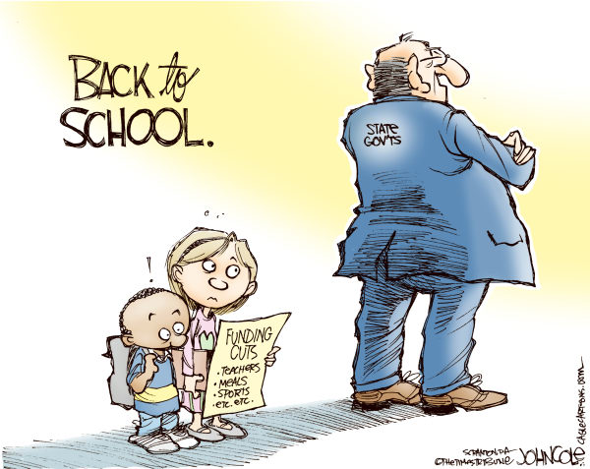
Effect of School Funding Inequalities on School Performance and Juvenile Crime
Constanza Schubert
Paulo Sosa
Lisbeth Santana

Slide 2
Motivation
Inspired by the rise of teacher-led strikes and protests and portrayal of their dire struggle by the media
Macro-view of school funding characteristics across the nation is created and a detailed investigation into the funding crisis in Florida
Florida per student funding increase is reserved for specific purposes
Only has 47 cents per student to help pay for the regular rising cost of doing school district business
Higher retirement benefits, growing utility costs, employee salary raises or expanded educational offerings
Notes:
Constanza
For instance, teachers across Oklahoma went on strike to protest low pay, overcrowded classrooms, and decreased education spending in April of this year. The strike ended 10 days later after an agreement to increase salaries and funding was reached.
Special purposes: school safety and mental health services

Slide 3
Background
The Florida Department of Education (FLDOE) oversees the Florida Education Finance Program (FEFP)
FEFP is supposed to guarantee that each student in the public education system has opportunities to programs and services appropriate to his or her educational needs, which are equal to a similar student
Formula is based on an individual student participating in a particular program and considers several factors, including varying property taxes, program costs, and costs of living
Claims the formula doesn’t discriminate where students live or their economic factors
Notes:
Constanza
While this may be true, theoretically, we’ll be examining whether systemic funding inequalities still arise and their impact

Slide 4
Questions/Goals
Is there a significant relationship between school funding attributes and juvenile crime on a national level?
In the case of Florida public schools:
Is there a significant relationship between school funding attributes and juvenile crime at a county level?
How does funding impact school performance? School performance is measured as follows:
School grades
School improvement ratings
State assessment scores
Notes:
Paulo
What we are trying to find out is the correlation between education and crime.

Slide 5
Methodology
Explore and gain a deep understanding of the data
Clean datasets, create visualizations, and merge data
Create predictive models for juvenile crime rates based on school funding attributes
Linear Regression ,Regression Trees
Create models for school performance using funding attributes
Hypothesis testing - charter vs non-charter schools
Compare results, make improvements, discuss future direction
Notes:
Constanza
Visualizations: funding inequality based on geography, tie this to demographics; juvenile crime based on geography
School performance: SAT/ACT scores, state assessments, school grades, improvement ratings

Slide 6
Progress
We have obtained all the data necessary from different repositories provided by the government and FLDOE
Education Funding
Arrests by category
Academic performance
We’ve grouped data by State and calculated the average per student for each states funding
The same is true for school districts in Florida -- average expenses/funding per student
Notes:
Paulo
Cleaned the data and created some visualizations
Next step is to finish merging finding data with arrest data and begin Florida-level analysis

Slide 7
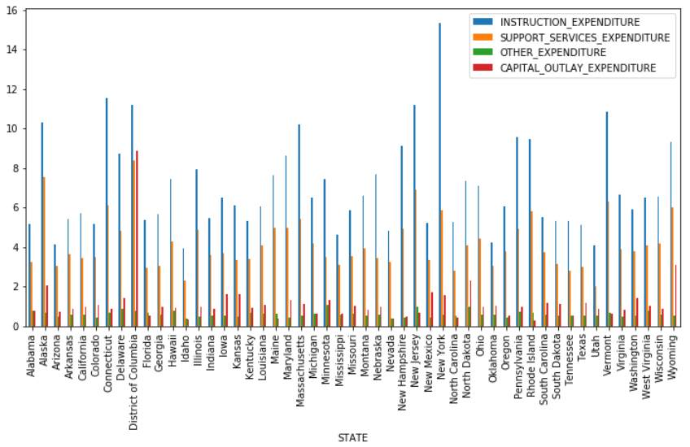
Notes:
Paulo

Slide 8
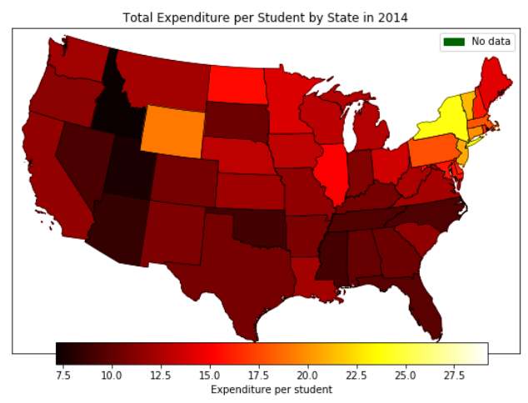
Notes:
Paulo

